Slide 1
Atomics and Critical Sections
These notes will introduce:
Accessing shared data by multiple threads
Atomics
Critical sections
Compare and swap instruction and usage
Memory fence instruction and usage
ITCS 6/8010 CUDA Programming, UNC-Charlotte, B. Wilkinson, Feb 10, 2011
Atomics.pptx

Slide 2
Accessing Shared Data
Accessing shared data needs careful control.
Consider two threads each of which is to add one to a shared data item, x.
Location x is read, x + 1 computed, and result written back to the same location:
Instruction
Thread 1
Thread 2
x = x + 1;
Read x
Compute x + 1
Write to x
Read x
Compute x + 1
Write to x
Time

Slide 3
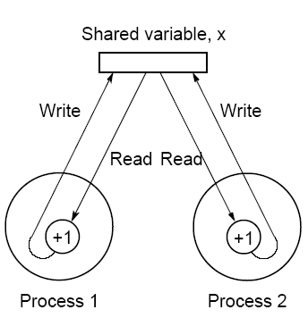
Conflict in accessing shared variable

Slide 4
One possible interleaving
Thread 1 Read x
Thread 1 Compute x + 1
Thread 1 Write to x
Thread 2 Read x
Thread 2 Compute x + 1
Thread 2 Write to x
Time
Suppose initial value of x is 10.
What is the final value?

Slide 5
Atomic Functions
Need to ensure that each thread is allowed exclusive access to shared variable to complete its operation (if a write operation is involved)
Atomic functions perform a read-modify-write operation on a word in shared memory without interference by other threads
Access to the memory location with specified address is blocked until atomic completed.

Slide 6
CUDA Atomic Operations
Performs a read-modify-write atomic operation on one word residing in global or shared GPU memory.
Associative operations on signed/unsigned integers, add, sub, min, max, and, or, xor, increment, decrement, exchange, compare and swap.
Requires GPU with compute capability 1.1+
(Shared memory operations and 64-bit words require higher capability)
coit-grid06 Tesla C2050 has compute capability 2.0
See http://www.nvidia.com/object/cuda_gpus.html for GPU compute capabilities

Slide 7
Example CUDA atomics*
int atomicAdd(int* address, int val);
Adds val to memory location given by address, atomically (atomic read-modify-write operation)
int atomicSub(int* address, int val);
Subtracts val from memory location given by address, atomically (atomic read-modify-write operation)
Functions returns original value in address.
* See CUDA C Programming Guide for full list

Slide 8
#include <stdio.h>
#include <cuda.h>
#include <stdlib.h>
__device__ int gpu_Count=0; //global variable in device
__global__ void gpu_Counter() {
atomicAdd(&gpu_Count,1);
}
int main(void) {
int cpu_Count;
…
gpu_Counter<<<B,T>>>();
cudaMemcpyFromSymbol(&cpu_Count, "gpu_Count",
sizeof(int), 0, cudaMemcpyDeviceToHost);
printf("Count = %d\n",cpu_Count);
…
return 0;
}
Example code
Synchronous, so cudaThreadSynchronize() not needed

Slide 9
Compilation Notes
Atomics only implemented on compute capability of 1.1 and above and extra features such as floating point add on later versions
Previous code will need to be compiled with -arch=sm_11 (or later) compile flag
Make file:
NVCC = /usr/local/cuda/bin/nvcc
CUDAPATH = /usr/local/cuda
NVCCFLAGS = -I$(CUDAPATH)/include -arch=sm_11
LFLAGS = -L$(CUDAPATH)/lib64 -lcuda -lcudart -lm
Counter:
$(NVCC) $(NVCCFLAGS) $(LFLAGS) -o Counter Counter.cu

Slide 10
Another Example
Computing Histogram
// globally accessible on gpu
__device__ int gpu_hist[10]; // histogram computed on gpu
__global__ void gpu_histogram(int *a, int N) {
int *ptr;
int tid = blockIdx.x * blockDim.x + threadIdx.x;
int numberThreads = blockDim.x * gridDim.x;
if (tid == 0)
for (int i = 0; i < 10; i++) // initialize histogram on host to all zeros
gpu_hist[i] = 0; // maybe a better way but may not be 10 tids
while (tid < N) {
ptr = &gpu_hist[a[tid]];
atomicAdd(ptr,1);
tid += numberThreads; // if no of threads less than N, threads reused
}
}

Slide 11
int main(int argc, char *argv[]) {
int T = 10, B = 10; // threads per block and blocks per grid
int N = 10; // Number of numbers
int *a; // ptr to array holding numbers on host
int *dev_a; // ptr to array holding numbers on device
int hist[10]; // final results from gpu
printf("Enter number of numbers, currently %d\n",N);
scanf("%d",&N);
input_thread_values(&B,&T); // keyboard input for no of threads and blocks
if (N > B * T) printf("Note; number of threads less than number of numbers\n");
int size = N * sizeof(int); // number of bytes in total in list of numbers
a = (int*) malloc(size);
srand(1); // set rand() seed to 1 for repeatability
for(int i=0;i<N;i++) // load arrays with digits
a[i] = rand() % 10;
cudaMalloc((void**)&dev_a, size);
cudaMemcpy(dev_a, a , size ,cudaMemcpyHostToDevice); // copy numbers to device
gpu_histogram<<<B,T>>>(dev_a,N);
cudaThreadSynchronize(); // wait for all threads to complete, needed?
cudaMemcpyFromSymbol(&hist, "gpu_hist", sizeof(hist), 0, cudaMemcpyDeviceToHost);
printf("Histogram, as computed on GPU\n");
for(int i = 0;i < 10;i++)
printf("Number of %d's = %d\n",i,hist[i]);
free(a); // clean up
cudaFree(dev_a);
return 0;
}

Slide 12
Other atomic operations
int atomicSub(int* address, int val);
int atomicExch(int* address, int val);
int atomicMin(int* address, int val);
int atomicMax(int* address, int val);
unsigned int atomicInc(unsigned int* address, unsigned int val);
unsigned int atomicDec(unsigned int* address, unsigned int val);
int atomicCAS(int* address, int compare, int val); //compare and swap
int atomicAnd(int* address, int val);
int atomicOr(int* address, int val);
int atomicXor(int* address, int val);
Source: NVIDIA CUDA C Programming Guide, version 3.2, 11/9/2010

Slide 13
Critical Sections
A mechanism for ensuring that only one process (or in this context, thread) accesses a particular resource at a time.
critical section – a section of code for accessing resource
Arrange that only one such critical section is executed at a time.
This mechanism is known as mutual exclusion.
Concept also appears in an operating systems.

Slide 14
Locks
Simplest mechanism for ensuring mutual exclusion of critical sections.
A lock - a 1-bit variable that is a 1 to indicate that a process has entered the critical section and a 0 to indicate that no process is in the critical section.
Operates much like that of a door lock:
A process coming to “door” of a critical section and finding it open may enter critical section, locking the door behind it to prevent other processes from entering.
Once process has finished the critical section, it unlocks the door and leaves.

Slide 15
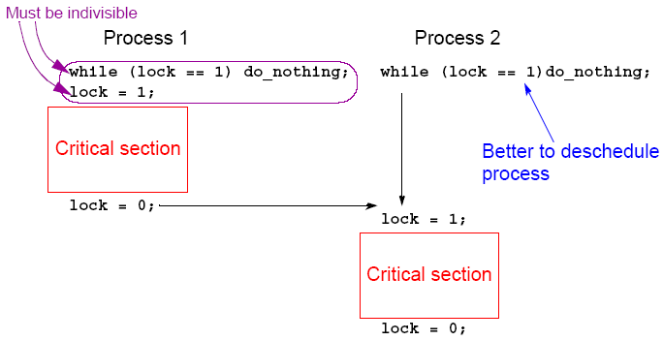
Control of critical sections through busy waiting

Slide 16
Implementing Locks
Checking lock and setting it if not set at the entrance to a critical section must be done indivisibly and atomically
Usual way to achieve this is for the processor to have special atomic machine instruction notably one of:
Test and set
Fetch and add
Compare and Swap CAS (or compare and exchange)

Slide 17
Compare and Swap CAS
CAS -- compares contents of a memory location to a given value and only if the same, modifies contents of the memory location to a specified value, i.e.:
if (x == compare_value ) x = new_val; (else x = x;)
For a critical section lock:
x = lock variable
compare_value = 0 (FALSE)
new_value = 1 (TRUE)

Slide 18
CUDA Functions for Locks
Among the CUDA atomic functions is compare and swap:
int atomicCAS(int* address, int compare_value,
int new_value);
Reads 32/64 bit global/shared memory location at address, compares contents with first supplied value compare_value and if the same stores in memory location the second supplied value, new_value.
Returns original value in address.

Slide 19
Coding Critical Sections with “Spin” Locks
__device__ int lock=0; // unlocked
__global__ void kernel(...) {
...
do {} while (atomicCAS(&lock,0,1) ); // if lock = 0 set to1
// and enter
... // critical section
lock = 0; // free lock
…
}
To be tested. BW

Slide 20
Critical Sections Serializing Code
High performance programs should have as few as possible critical sections as their use can serialize the code.
Suppose, all processes happen to come to their critical section together.
They will execute their critical sections one after the other.
In that situation, the execution time becomes almost that of a single processor.

Slide 21
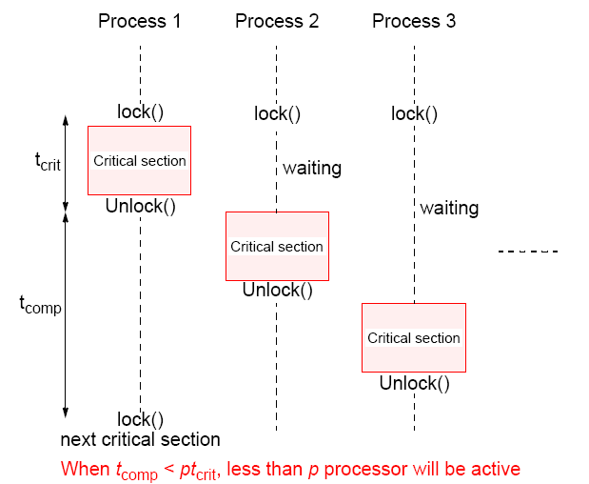
Illustration

Slide 22
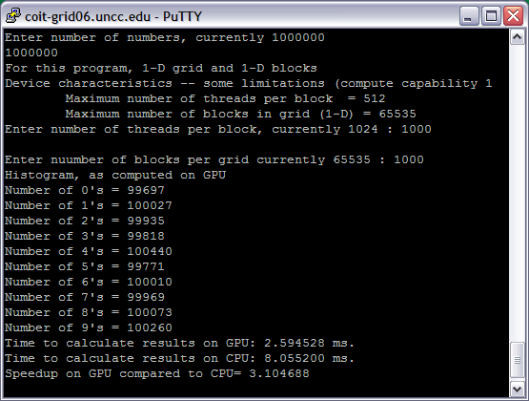
Results from Histogram program

Slide 23
Less threads than numbers causes threads to be reused in counting, so slower
3.1 seems max because of accesses to shared histogram array
More threads than numbers obviously will not help

Slide 24
Memory Fences
Threads may see effects of a series of writes to memory executed by another thread in different orders. To enforce ordering:
void __threadfence_block();
waits until all global and shared memory accesses made by calling thread prior to __threadfence_block() are visible to all threads in thread block.
Other routines:
void __threadfence();
void __threadfence_system();

Slide 25
Critical sections with memory operations
Writes to device memory not guaranteed in any order, so global writes may not have completed by the time the lock is unlocked
__global__ void kernel(...) {
...
do {} while(atomicCAS(&lock,0,1));
... // critical section
__threadfence(); // wait for writes to finish
lock = 0;
}

Slide 26
Questions

